Slide 1
ECSC 325.200
Web Server Administration
Spring 2025 – Week 4-1 – February 4th, 2025
Users & Groups, Command Line, Startup & Shutdown
Prof. Jason Patalon

Slide 2

Weekly Info
“Success is no accident. It is hard work, perseverance, learning, studying,
sacrifice, and most of all, love of what you are doing” - Pele
Scientists have found new Earth like planets?
  7 planets found in the “Goldilocks” zone of a nearby star?!
Attendance
Good of the Class
Assignment 3 due February 5th

Slide 3

Recap and Review
The next few weeks…
  Users, permissions, installations, DNS, & stuff
  Midterm – February 27th, 2025
Corrections, updates, etc.
  Minor updates to previous presentations…
Review of previous assignments
  This Week?
Questions from previous classes?
Etcetera
  Spectrum is one of the fastest growing companies in America?!

Slide 4
Documentation Expectations
Documentation expectations examples:
  Edit the network configuration file /etc/sysconfig/network-scripts/ifcfg-bond0
    Updated the following information in the network configuration file:
      IPADDR=147.64.243.115
      HOSTMASK=255.255.254.0
      DNS1=147.64.242.100
      DNS2=147.64.242.101
  Restarted the network services to apply configuration changes
      systemctl restart network
  Added entry to /etc/fstab file for persistent mount
    147.64.243.115:/data /data nfs bg,rw,sync,hard,intr 0 0
  Updated and rebooted the system
      dnf –y update; reboot

Slide 5

Incorrect Commands and Autocorrect
Microsoft products love to autocorrect things!
  Capitalization
    nslookup is changed to Nslookup if it is the first word in a line…
  Some characters
    - is changed to –
  Multiple characters
    -- is changed to –
  Other things
  Tabs
    Copying and pasting tabs can cause complications
  I try to correct these things where I can, but I am sure to miss some!
    Sorry not sorry?

Slide 6

Objectives
Managing users and groups
  Passwd, shadow, group files
  User management tools
  Permissions
The command line
  Bash
  Command line shortcuts
  Documentation tools
  Files, file types, file ownership, file permissions
  File compression and manipulation
  Additional file management tools
Network Connections
Booting and shutting down
  Boot Loaders
  Initialization Process
  Service startups and runlevels/targets
  Recovery Mode
Other Topics
  Linux Directories
  SSH
  VNC and RDP
  Virtual Machines
  Sudo, su, visudo

Slide 7
Assignment 2 review
Three reasons to prefer virtual servers
  Easier maintenance and administration
  Better hardware utilization
  Lower cost
  Better backups…
Email service is considered high priority because it is used by almost everyone in an organization and facilitates the flow of information critical for many regular business operations. High-level features should include HA characteristics (fault-tolerant design and redundant systems), anti-spam and anti-virus services, along with regular backups.
N+1 redundancy means we have one more item than is necessary for normal operation, that can take over operation in case of a failure. An example is multiple redundant network connections.
I like RAID 5 for network accessible storage arrays. RAID 5 with a hot spare is also nice. RAID 6 is OK too, but costs more and can be slower than RAID 5. RAID 1 would be good for small volumes.

Slide 8
Assignment 2 review
Fault Tolerance
  Redundant hardware that can take over immediately in the event of a failure
  Can be expensive, and does not address software failures
  Typically desired wherever possible
  Examples: redundant power supplies or redundant network connections
High Availability
  Uses software to manage availability of services
  Restores services after a failure, potentially on different hardware
  Minimize interruptions during software failures
  Example: Failover database cluster
Fault Domains?!

Slide 9
Assignment 2 review
Single-Mode Fiber
  Smaller core, fewer internal reflections.
  Fewer possible light transmission frequencies.
  Better suited for longer distances (between buildings, internet backbones, etc.)
Multi-Mode Fiber
  Larger core, more internal reflections.
  More possible light transmission frequencies.
  Distortion at longer distances, better suited for shorter distances (within a building)
DR Recovery
  Infrastructure tier first!
  Underlying hardware and critical network services
    Servers, storage, and switches/routers
    DNS/DHCP/NTP/AD/etc.

Slide 10

Connecting to our VM’s
New method of connecting to CS Network
Connect to VPN
  Windows Thick Client
  Windows L2TP
  MacOS L2TP
  Chromebook/Linux L2TP?
    Untested…
EUP-CS VPN
  Remote host: 147.64.2.12 (vpn.cs.edinboro.edu or vpn.ultrastuff.net)
  Pre-Shared Key: <credentials.txt>
  Username and password for students
    Username: <credentials.txt>
    Password: <credentials.txt>
Creds in credentials.txt

Slide 11
Create a VPN Connection – Windows Client
Windows – Sonicwall VPN Client
  Download and install the client
    https://software.sonicwall.com/GlobalVPNClient/184-011921-00_REV_A_GVCSetup64.exe
  Give the connection a name: EUP-CS VPN
  Remote host: 147.64.2.12 (vpn.cs.edinboro.edu or vpn.ultrastuff.net)
  Pre-Shared Key: <credentials.txt>
  Username and password for students
    Username: <credentials.txt>
    Password: <credentials.txt>
  Enable the connection!
Creds in credentials.txt

Slide 12
Create a VPN Connection – Windows L2TP
Windows – Layer 2 Tunneling Protocol (L2TP/IPsec)
  Start → Settings → Network & Internet → VPN
    Add VPN
  Give it a name: EUP-CS VPN
  Server address: 147.64.2.12 (vpn.cs.edinboro.edu or vpn.ultrastuff.net)
  VPN Type: L2TP/IPSec with pre-shared key
  Pre-Shared Key: <credentials.txt>
  Username and password for students
    Username: <credentials.txt>
    Password: <credentials.txt>
  Connect on the VPN network!
  You may need to enable the option to tunnel all traffic through the VPN…
Creds in credentials.txt

Slide 13
Create a VPN Connection – MacOS L2TP
Mac OS – Layer 2 Tunneling Protocol (L2TP/IPsec)
  System Preferences → Network
    Three dots in lower right corner → Add VPN Config → L2TP over IPSec
  Give it a name: EUP-CS VPN
  Server address: 147.64.2.12 (vpn.cs.edinboro.edu or vpn.ultrastuff.net
  Pre-Shared Key: <credentials.txt>
  Username and password for students
    Username: <credentials.txt>
    Password: <credentials.txt>
  Connect on the VPN network!
  You may need to enable the option to tunnel all traffic through the VPN…
Creds in credentials.txt

Slide 14
Create a VPN Connection – Chromebook L2TP/IPsec
Chromebook – Layer 2 Tunneling Protocol (L2TP/IPsec)
  Settings→ Network
  Add built-in VPN → Add connection
  Give it a name: EUP-CS VPN
  Authentication type: Pre-shared key
  Server hostname: 147.64.2.12 (vpn.cs.edinboro.edu or vpn.ultrastuff.net)
  Pre-Shared Key: <credentials.txt>
  Username and password for students
    Username: <credentials.txt>
    Password: <credentials.txt>
  Connect on the VPN network!
  You may need to enable the option to tunnel all traffic through the VPN…
  https://support.google.com/chromebook/answer/1282338?hl=en#zippy=%2Cltpipsec-vpn-support
Creds in credentials.txt

Slide 15
Connect to CS VPN with a SSH Connection
Open a command prompt terminal
    In Windows, a cmd shell or powershell
    In Linux, your default command line shell
  SSH to the server jpatalon.cs.edinboro.edu on port 54321
    You will need to use the format of username@jpatalon.cs.edinboro.edu to specify the
    correct username when connecting!
    The username and password are contained in the credentials file within D2L
  Example connection commands
    ssh user@jpatalon.cs.edinboro.edu -p 54321
Creds in credentials.txt
ssh cs_student@jpatalon.cs.edinboro.edu –p 54321

Slide 16
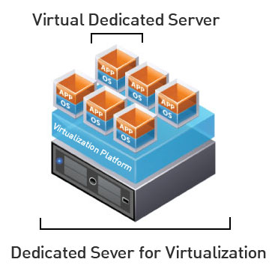
Connecting to our VM’s
IP Address: 147.64.243.1## (01-25)
  Use your two digit number from below!
Hostname: ecsc325-1##.cs.edinboro.edu (01-25)
  Use your two digit number from below!
Default root password: <credentials.txt>
Two digit number:
  Tanner A: 01
  Freyja B: 02
  Osaretin I: 03
  Derek J: 04
  Benjamin K: 05
  Dennis V: 06
Aliases will be used in the future…

Slide 17

Booting and shutting down
Boot Loaders – Software that executes after the BIOS completes
  GRUB/GRUB 2, NTLDR, Windows Boot Manager
Initialization Process
  Multiple levels achieve different runlevels/targets
  Runlevel 1 – rescue.target – Single user mode
  Runlevel 3 – multi-user.target – Full multiuser mode
  Runlevel 5 – graphical.target – Full multiuser mode with GUI
Recovery Mode
  Boot into a single user mode
    Repair a filesystem if necessary
    May need root password
  Boot from CD/iso into a recovery mode, mount the filesystem, get root
    Fix your broken VM’s after a botched update (remotely, from the beach of course)

Slide 18

Services
A Linux service is a process or a set of processes running in the background. These kinds of processes are usually in charge of executing essential system tasks or running certain kinds of server applications like databases, schedule applications, or even sound system applications.
An example service would be an http server.
Services can be enabled (automatically starts on boot) or disabled with sytemctl.
  systemctl enable httpd
  systemctl disable httpd
Service status can be started and stopped with the systemctl start/stop commands
  systemctl start httpd
  systemctl stop httpd
Service status can be checked with the systemctl status command
  systemctl status httpd

Slide 19
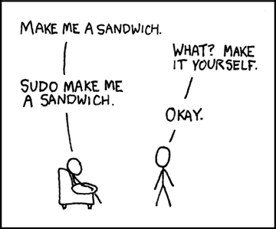
Sudoers
Controls who can run what commands as what users on what machines
  Can also control special things such as whether you need a password for particular commands
List of users with sudo priviliges maintained in /etc/sudoers file and in /etc/sudoers.d/ files
Sudoers file is edited with visudo command
  visudo command performs basic validations when saving the file to help prevent errors
  Default editor is vi, can be changed if desired
Default syntax is below:
  <user list> <host list> = <operator list> <tag list> <command list>
  Ex: root ALL=(ALL) ALL
    Root can run all commands as all users on all servers
  Tags can be used to set special options (NOPASSWD, etc)
Aliases (variables) can be used for lists of users, hosts, commands, etc.

Slide 20

Other Topics
SSH – Secure Shell
  Creates an encrypted terminal connection to a server shell
  Allows for other types of communication to be tunneled through connection
    Tunneling insecure information through a secure tunnel creates a secure connection!
  In Windows, you can use the program Putty to SSH in to a server
  Reverse SSH?!
  In Linux/MacOS, you can run the SSH command directly from the command line
    ssh user@host
    ssh root@ecsc325-120.math.cs.edinboro.edu
From off campus, log on to cslab100 or cslab101, then SSH to your VM.

Slide 21
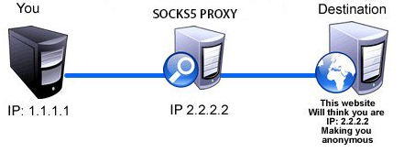
SSH Tunnels
SSH Tunnels are secure and encrypted between endpoints!
Local port forwarding
  Similar to port forwarding on a router
  ssh -L source_port:destination_host:destination_port user@host.tld
    Ex: ssh -L 4567:ecsc325-120.math.cs.edinboro.edu:22 jpatalon@cslab100.cs.edinboro.edu
    This command opens an encrypted tunnel between my local machine and ssh server cslab100.cs.edinboro.edu
    Traffic sent to localhost port 4567 is redirected to ecsc325-120.math.cs.edinboro.edu port 22
Notes:
ssh -L 4567:cslab189.cs.edinboro.edu:3389 jpatalon@cslab100.cs.edinboro.edu

Slide 22
SSH Tunnels
SOCKS Proxy – Dynamic Port Forwarding
  Allows for website proxying (other traffic too!)
  Can be used to allow connections around firewalls
    Connect to your ecsc325 web server from anywhere through an intermediate host
  ssh –D port user@host.tld
    Ex: ssh –D 55555 jpatalon@cslab100.cs.edinboro.edu
    This command opens an encrypted tunnel between my local machine and ssh server cslab100.cs.edinboro.edu
    SOCKS traffic is sent through port 5555 to server cslab100.cs.edinboro.edu, where it is then forwarded to the destination
Notes:
We can also create SSH tunnels through multiple devices!

Slide 23

Other Topics
VNC and RDP
  Allow for a connection to a server GUI
  Can be used for in-band and out-of-band connections
  RDP (Remote Desktop Protocol) is common in Windows environments
  VNC is common most other environments
    VNC connections are typically not encrypted (or poorly encrypted),
    and tunneled through encrypted SSH connections.
  VNC connections are sometimes only allowed from the localhost
    Allowing connections only from localhost prevents unencrypted connections
    You must tunnel through SSH before initiating VNC, forcing encryption

Slide 24

Redirect command output to a file
cat /var/log/boot
  Output’s contents of /var/log/boot file
cat /var/log/boot.log | wc
  Pipe will redirect the output from the command to the input of another command
  Send the output of the file to the wc command (tell us how many lines/words/characters are in the file)
cat /var/log/boot | wc > /tmp/text1.txt
  Single greater than symbol!
  Print the output from the command to the file /tmp/text1.txt, overwriting anything in the file
cat /var/log/boot | wc >> /tmp/text1.txt
  Two greater than symbols!
  Print the output from the command to the file /tmp/text1.txt, appending to the end of the file

Slide 25

The Command Line
List files, file types, file ownership, file permissions
  ls command will show us these items
  ls is short for list
  ls command can take many options
    -l gives the long listing (lower case L)
    -a gives all files, including files
    -t sorts by modified time
    -r reverse
    -h human readable
The ls command (lowercase LS)

Slide 26
The Command Line
Directory structure navigation
  cd command lets us change directories
    cd /home/user/
  cd command by itself changes to users home directory
    cd
  Parent directory is represented by two periods
    cd ..
  pwd shows us what directory we are currently in
    [user@ecsc325 ~]$ pwd
    /home/user
  Files are edited with an editor
    vi, nano, joe, etc.
  Executables are executed
    /tmp/script.sh
The CD command (lowercase cd)

Slide 27
Permissions
Octal Modes
  1 – Execute
  2 – Write
  3 – Write & Execute
  4 – Read
  5 – Read & Execute
  6 – Read & Write
  7 – Read, Write, & Execute
Octal modes are set, overwriting any current modes that are already set
  Ex: chmod 750 /root/folder/file.txt
Symbolic Modes
  u = user
  g = group
  o = other
  a = all
  r = read
  w = write
  x = execute
Symbolic modes are additive and subtractive, adding to or removing from currently set permissions
  Ex: chmod ug+rwX,o-rwx /root/folder/file.txt
Octal modes set permissions, symbolic modes can add and remove

Slide 28
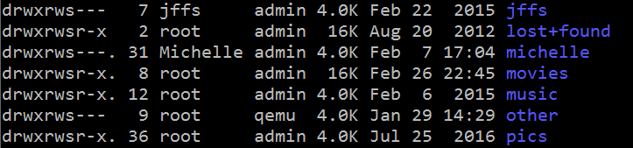
Ownership
Set file user owner
  chown username file.txt
Set file group owner
  chgrp groupname file.txt
Set both user and group owner
  chown username:groupname file.txt
Represented by the ls -l command as such:

Slide 29
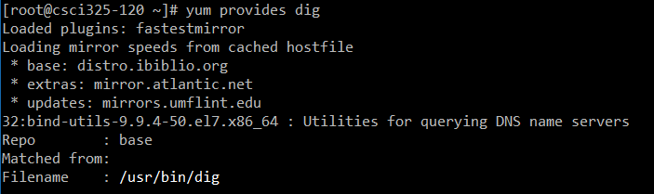

Package Management
yum – Manage installed packages and software
  Red Hat and similar systems (Fedora, CentOS, etc)
  Maintains a list of packages and dependencies
  yum search <package>
  yum install <package>
  yum provides <command>
  yum update
RPM describes the package format
YUM maintains RPM’s and dependencies

Slide 30
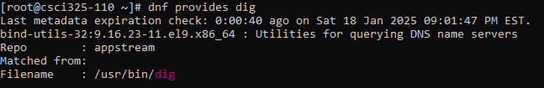

Package Management
dnf – Manage installed packages and software
  Red Hat and similar systems (Fedora, CentOS, etc)
  Maintains a list of packages and dependencies
  dnf search <package>
  dnf install <package>
  dnf provides <command>
  dnf update
Dandified Yellowdog Updater Modified

Slide 31

Network Address Translation (NAT)
The process of modifying IP address information in packets while traversing a routing device
Allows for 1 public IP address to be shared by many private IP address
Private IP address ranges:
  10.0.0.0/8 (10.0.0.0 – 10.255.255.255)
  172.16.0.0/12 (172.16.0.0 – 172.31.255.255)
  192.168.0.0/16 (192.168.0.0 – 192.168.255.255)
NAT maps private IP’s to a port
on the public IP network

Slide 32
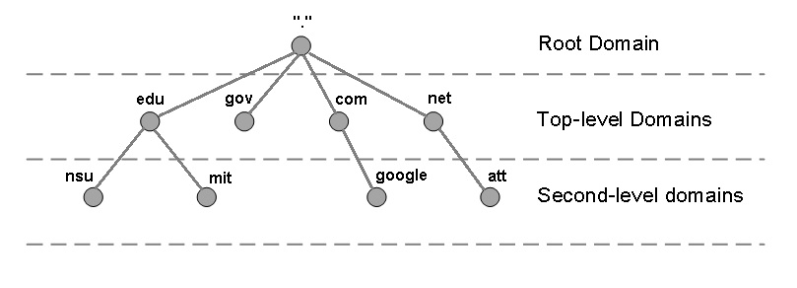
Domain Name System (DNS)
A hierarchical distributed naming system for any resource connected to the Internet or a private network.
Associates various information with domain names
Translates domain names into IP addresses
Top servers in DNS hierarchy are called root nameservers
Next level of servers in hierarchy are called Top Level Domains (TLDs)
  .com, .net, .edu, .biz, etc.
Following level is called the Second Level
  Google.com, Edinboro.edu, co.uk
Multiple following levels and hostname
  cslab100.cs.edinboro.edu - 147.64.242.100 (A record)
Notes:
IP addresses are analogous to telephone numbers
DNS Servers maintain the telephone directory

Slide 33
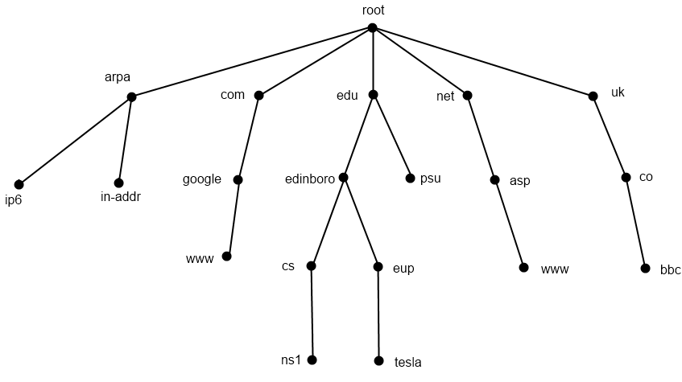
DNS Hierarchical View
13 root nameserver maintainers!
Notes:
13 Root nameservers maintainers, such as verisign, nasa & U of Maryland
259 total root servers (as of 11/30/11)
273 TLD’s
63 characters per level
127 levels max
253 characters per FQDN

Slide 34
DNS Record Types
Type Description Function
A Address Record 32-bit IPv4
AAAA IPv6 Address Record 128-bit IPv6
CNAME Canonical Name Alias; Nickname
MX Mail Exchange Mail Server
NS Name Server DNS Records
PTR Pointer Record Reverse DNS
SOA Start of Authority Authoritative Info
TXT Text Record Various (spf, mail, pub encryption key, etc)
SPF Sender Policy Framework E-Mail validation information
Notes:
Many more types of records available

Slide 35
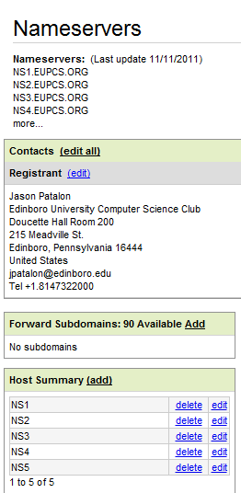
DNS Glue Records
IP addresses of nameservers at parent
A and AAAA
Configured at parent or registrar
  GoDaddy, NameCheap, Google Domains, etc.
  Edinboro.edu for a subdomain
    cs.edinboro.edu

Slide 36

Whois Records
More detailed information specifically about the domain
whois eupcs.org
  Registrant ID:CR36875534
  Registrant Name:Jason Patalon
  Registrant Organization:Edinboro University Computer Science Club
  Registrant Street1:Doucette Hall Room 200
  Registrant Street2:215 Meadville St.
  Registrant Street3:
  Registrant City:Edinboro
  Registrant State/Province:Pennsylvania
  Registrant Postal Code:16444
  Registrant Country:US
  Registrant Phone:+1.8147322000
  Registrant Phone Ext.:
  Registrant FAX:
  Registrant FAX Ext.:
  Registrant Email:jpatalon@edinboro.edu
Additional data such as billing, technical, and other contact info available

Slide 37
Looking up records
DNS Tools can be installed on your virtual machine, or run from a cslab server
  Install Dig, NSLookup, & Whois!
    dnf provides dig
    dnf provides nslookup
    dnf provides whois
    dnf install bind-utils whois
NSLookup command examples:
    nslookup google.com (looks up A record by default)
    nslookup -querytype=MX google.com (specify record type to look up)
    nslookup -querytype=MX google.com 8.8.8.8 (specify server to query)
Dig command examples:
    dig google.com (looks up A record by default)
    dig mx google.com (specify record type to look up)
    dig mx google.com @8.8.8.8 (specify server to query)

Slide 38
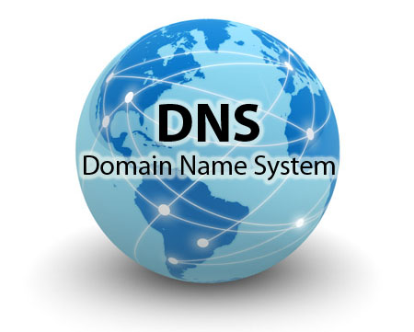
Hosts Files
The host files can maintain IP address entries
Host file entries may take precedence over DNS servers!
  May need to validate there aren’t conflicting records!
Host files can be configured per host
Host file location
  Linux: /etc/hosts
  Windows: C:\Windows\System32\Drivers\etc\hosts
Can be used to provide responses if DNS server is down
  Additional form of redundancy
  Additional complexity and overhead to maintain

Slide 39

Commands
nslookup – Perform simple nameserver queries
  Supports lookup of different address types, and target resolver
  Usage: nslookup [-option] [name | -] [server]
  Ex: nslookup google.com 8.8.4.4
dig – Perform more detailed nameserver queries
  Supports lookup of different address types, and target resolver
  Usage: dig [@global-server] [domain] [q-type] [q-class] {q-opt}
  {global-d-opt} host [@local-server] {local-d-opt}
  [ host [@local-server] {local-d-opt} [...]]
  Ex: dig AAAA google.com @8.8.8.8

Slide 40
Nameserver Types
Master (Primary)
  Main server for authoritative DNS zones.
Slave (Secondary)
  Backup server for authoritative DNS zones.
Caching
  Maintains cache of recent DNS lookups.
Recursive
  Provides lookups for non-authoritative DNS zones.
Stealth
  Hidden nameservers.
Root
  Servers at the top (root) of the DNS hierarchy
Parent
  Name server at the next level up in the DNS hierarchy
A single nameserver can perform one or more functions!
Notes:
Servers can be both recursive and non-recursive depending on source of query
A single server can act as multiple types

Slide 41
Time To Live (TTL)
Limits the lifespan of a record
Specified in seconds
Caching nameservers keep records for amount of time dictated by TTL
Shorter TTL’s increase load on nameserver
Longer TTL’s leave stale records unrefreshed longer
TTL’s can be manipulated to decrease service outages
  Set your TTL value low before changing a record
  that may impact service or cause an outage

Slide 42
Fully Qualified Domain Name (FQDN)
cslab100.cs.edinboro.edu
TLD: edu
  Top Level Domain (.com, .net, .org, .uk, etc)
Second Level Domain: edinboro
  Another SLD could be .co.uk
Subdomain: cs
Host: cslab100

Slide 43
IP Address Subnetting
147.64.242.100
CIDR Notation: 147.64.242.100/16
Subnet Mask: 255.255.0.0
Network Prefix: 147.64.
Host Suffix: 242.100

Slide 44
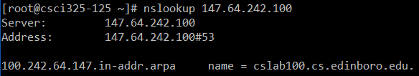
IP Address Subnetting
147.64.242.100
100.242.64.147.in-addr.arpa name = cslab100.cs.edinboro.edu
TLD = arpa
SLD = in-addr
PTR record!

Slide 45
DNS Record Types
Type Description Function
A Address Record 32-bit IPv4
AAAA IPv6 Address Record 128-bit IPv6
CNAME Canonical Name Alias; Nickname
MX Mail Exchange Mail Server
NS Name Server DNS Records
PTR Pointer Record Reverse DNS
SOA Start of Authority Authoritative Info
TXT Text Record Various (spf, mail, pub encryption key, etc)
SPF Sender Policy Framework E-Mail validation information
Notes:
Many more types of records available

Slide 46
A, AAAA, MX, CNAME and TXT Records
edinboro.edu. A 147.64.32.245
edinboro.edu. A 147.64.32.6
edinboro.edu. AAAA 2002:9340:2006::9340:2006
edinboro.edu. AAAA 2002:9340:20f5::9340:20f5
chemstock CNAME chemstock-p.cs.edinboro.edu.
edinboro.edu. MX 5 spamblock.edinboro.edu.
edinboro.edu. MX 10 spamblock2.edinboro.edu.
edinboro.edu. TXT "v=spf1 ip4:147.64.32.99/32 ip4:147.64.32.120/32 ip4:147.64.32.121/32 ip4:147.64.32.205 ip4:147.64.32.206 ~all"
scots TXT "v=spf1 include:exchangelabs.com ~all"
Many of these records have changed!
Notes:
Trailing period completes domain
Records without trailing period append domain name
MX records indicate mail server priority
TXT records shows SPF record; SPF in TXT has been deprecated, SPF has its own record type

Slide 47
Start of Authority Record (SOA)
eupcs.org IN SOA ns1.eupcs.org. jpatalon.edinboro.edu. (
2011111117 ; serial
21600 ; refresh (6 hours)
600 ; retry (10 minutes)
1209600 ; expire (2 weeks)
10800 ; minimum (3 hours)
)
dig soa eupcs.org
Notes:
RFC 1035 Defines SOA
RFC 1912 specifies serial in format YYYYMMDDnn
Email format replaces first period with an @ sign (ex: jpatalon.Edinboro.edu = jpatalon@Edinboro.edu); escape the first period with a backslash if desired (jason.\.patalon.Edinboro.edu)

Slide 48
Start of Authority Record (SOA)
Refresh
  How often slave tries to refresh zone from master.
Retry
  How long slave should wait to refresh zone from master if the refresh failed.
Expire
  Amount of time until slave server can no longer be considered authoritative for zone.
Minimum (negative caching time)
  How long an error on a record can be kept before another lookup must be performed.
Notes:
RFC 1912 specifies refresh, retry, expire
RFC 2308 specifies minimum

Slide 49
Example BIND File
$ORIGIN .
$TTL 10800 ; 12 hours
eupcs.org IN SOA ns1.eupcs.org. jpatalon.edinboro.edu. (
2011111105 ; serial
21600 ; refresh (6 hours)
600 ; retry (10 minutes)
1209600 ; expire (2 weeks)
10800 ; minimum (3 hours)
)
NS ns1.eupcs.org.
NS ns2.eupcs.org.
NS ns3.eupcs.org.
NS ns4.eupcs.org.
NS ns5.eupcs.org.
A 147.64.242.100
MX 10 mail.eupcs.org.
$ORIGIN eupcs.org.
mail A 147.64.242.100
ns1 A 147.64.242.100
ns2 A 147.64.242.101
ns3 A 147.64.243.20
ns4 A 147.64.243.21
ns5 A 174.100.246.93
www CNAME eupcs.org.

Slide 50
IPv4 vs. IPv6
IPv4
  A (single a) DNS record type
  32 bit
  2^32 available addresses
    4,294,967,296
IPv6
  AAAA (quad a) DNS record type
  128 bit
  2^128 available addresses
    340,282,366,920,938,000,000,000,000,000,000,000,000
Notes:
February 2011 – IPv4 address pool exhausted.
March 2011 – Nortel Networks sold 666,624 IPv4 address to Microsoft for $7.5million - $11.25 per IP address

Slide 51
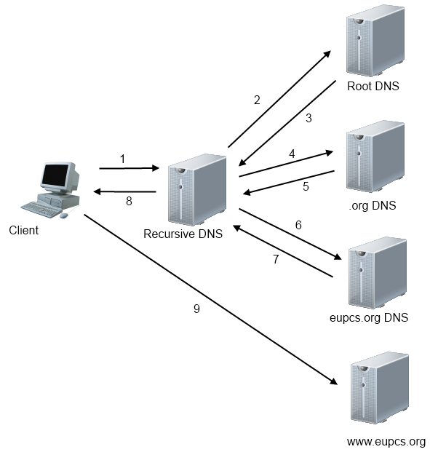
DNS Transaction

Slide 52
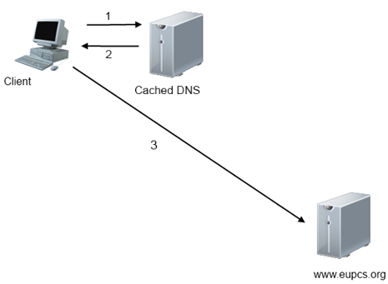
Cached DNS Transaction

Slide 53
DNS Transaction
DNS Record: www.eupcs.org
dig ns
  Response: a.root-servers.net
dig ns org @a.root-servers.net
  Response: a0.org.afilias-nst.info
dig ns eupcs.org @a0.org.afilias-nst.info
  Response: ns1.eupcs.org
dig a www.eupcs.org @ns1.eupcs.org
  Response: 147.64.242.60
Root Hints!
Notes:
Root hints tell a name server the initial root DNS server IP addresses. Root hints are maintained locally on a recursive DNS server.

Slide 54
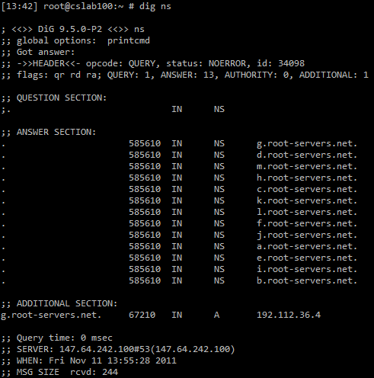
dig ns

Slide 55
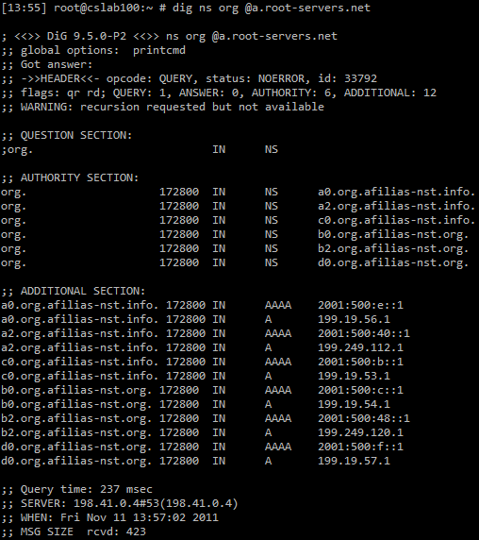
dig ns org @a.root-servers.net

Slide 56
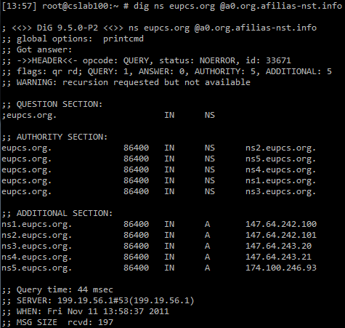
dig ns eupcs.org @a0.org.afilias-nst.info

Slide 57
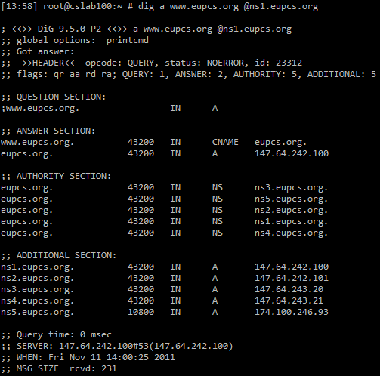
dig a www.eupcs.org @ns1.eupcs.org

Slide 58
RDNS Transaction (IP: 147.64.242.100)
RDNS Record: 100.242.64.147.in-addr.arpa
dig ns
dig ns arpa @a.root-servers.net
dig ns in-addr.arpa @a.in-addr-servers.arpa
dig ns 147.in-addr.arpa @a.in-addr-servers.arpa
dig ns 64.147.in-addr.arpa @a.in-addr-servers.arpa
dig ns 242.64.147.in-addr.arpa @edinborodc01.edinboro.edu
dig ptr 100.242.64.147.in-addr.arpa @ns1.cs.edinboro.edu

Slide 59
Recursive vs. Non-Recursive
A recursive DNS server will respond to any DNS query with a non-authoritative answer
  [14:11] root@cslab100:~ # nslookup yahoo.com google-public-dns-a.google.com
  Server: 8.8.8.8
  Address: 8.8.8.8#53
  Non-authoritative answer:
  Name: yahoo.com
  Address: 98.139.180.149
Notes:
DDOS against recursive servers
Recursive may only be allowed depending on source of query

Slide 60
Recursive vs. Non-Recursive
A non-recursive DNS server will only respond to a DNS query for a zone it is authoritative for
  [15:54] root@cslab100:~ # nslookup yahoo.com ns1.google.com
  Server: ns1.google.com
  Address: 216.239.32.10#53
  ** server can't find yahoo.com.cs.edinboro.edu: REFUSED
  [15:54] root@cslab100:~ # nslookup google.com ns1.google.com
  Server: ns1.google.com
  Address: 216.239.32.10#53
  Name: google.com
  Address: 172.217.12.142
Notes:
DDOS against recursive servers
Recursive may only be allowed depending on source of query

Slide 61
DNS Clients
DNS Clients can cache information
  Typically will follow TTL values
  DNS cache can be flushed
    Windows: ipconfig /flushdns
    Linux: service ncsd restart
    Linux: service dnsmasq restart
    Linux: rndc restart
  Client configuration files
    /etc/hosts
      Hardcoded hosts addresses
    /etc/resolv.conf
      DNS Resolver info
    /etc/nsswitch.conf
Negative Caching

Slide 62
DNS Versions
The version of a DNS server can be queried with the following command:
  dig @nameserver version.bind txt chaos
  Ex: dig @ns1.megastuff.biz version.bind txt chaos
      ;; QUESTION SECTION:
      ;version.bind. CH TXT
      ;; ANSWER SECTION:
      version.bind. 86400 CH TXT "Salt-master"
  Ex: dig @edinborodc02.edinboro.edu version.bind txt chaos
      ;; QUESTION SECTION:
      ;version.bind. CH TXT
      ;; ANSWER SECTION:
      version.bind. 1476526080 IN TXT "Microsoft DNS 6.1.7601 (1DB15D39)"

Slide 63
Source-Based DNS
DNS servers can be configured to give different responses depending on the querying source
  Internal vs. External
    Internally, you may be able to resolve DNS address that you don’t want to expose externally
    Different nameservers for different query sources
    Only expose certain records to certain sources
      Internal server records only exposed internally
  Geo-location based DNS responses – provide a different response based on your location
    Geo-restrictions or geo-blocking
    Can force users of specific locations to use specific DNS services
    Services like SmartDNS and Unblock-us provide workarounds at a cost
      You use these services as your DNS resolver, it looks up addresses on your behalf from a different geographic location
  Edinboro uses source-based DNS to provide different responses internally vs. externally
    Lookup the NS records for edinboro.edu from on campus and also from off campus…

Slide 64
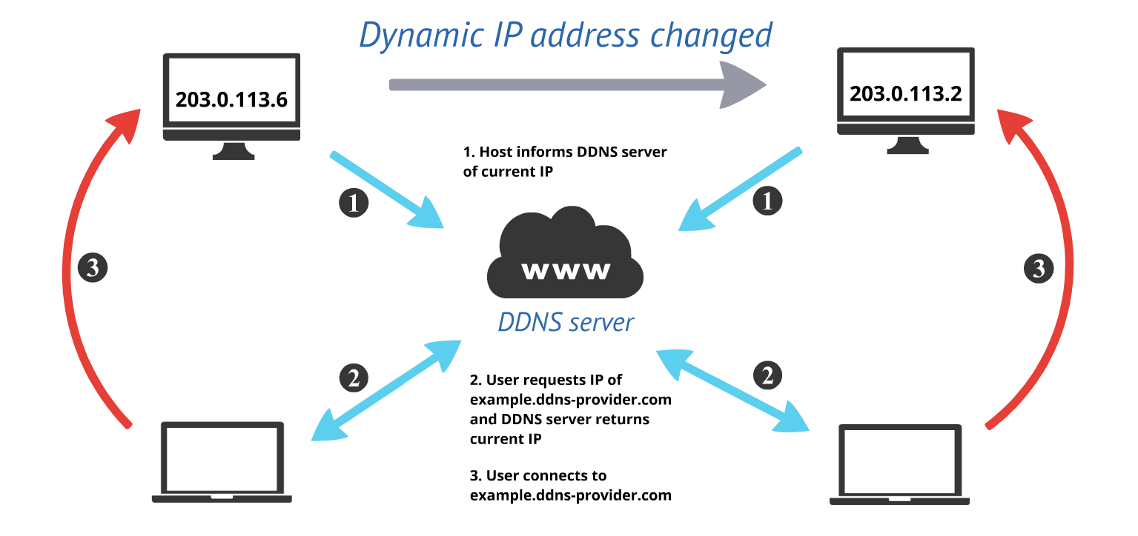
Dynamic DNS (DDNS)
Automatically updating a DNS record in real-time
  Often used with DHCP
  DHCP server hands out an IP address, and updates the DNS server with the new name/IP record
    Company desktops or laptops that may receive different IP addresses
    Users connect to company desktops or laptops by hostname
  Commercial solutions can provide
  Dynamic DNS services to consumers
    Your home IP address may change at the whim of the ISP
    An application can be configured to provide IP updates
    to a service provider
    DynDNS or similar providers
      Some services are free to non-commercial users!
    Make sure I can always connect to my house, no
    matter what my IP address is!

Slide 65
Best Practices
Primary nameserver should be stealth!
Public nameservers should be slaves.
Have at least 3 public nameservers.
Public nameservers should not be recursive.
Nameserver version should be hidden.
Glue records should be used!
Nameservers should accept both TCP and UDP!
Nameservers should be on separate networks.
TTL Values should follow RFC recommendations.
Notes:
3 nameservers: RFC 2182
UDP Packets 512bytes

Slide 66
DNS Checks
Intodns.com
  Checks a variety of DNS settings
  http://www.intodns.com/eupcs.org
  http://www.intodns.com/mtsd.org
  http://www.intodns.com/edinboro.edu
  http://www.intodns.com/megastuff.biz

Slide 67

DNS: More Reading…
en.wikipedia.org/wiki/Domain_Name_System
intodns.com
root-servers.org
domainincite.com/microsoft-spends-7-5-million-on-ip-addresses
www.dnsvalidation.com
www.cisco.com/web/about/security/intelligence/dns-bcp.html
technet.microsoft.com/en-us/library/cc778439(WS.10).aspx
www.zytrax.com/books/dns/

Slide 68
Looking up records
DNS Tools can be installed on your virtual machine…
  Install Dig, NSLookup, & Whois!
      dnf provides dig
      dnf provides nslookup
      dnf provides whois
      dnf install bind-utils whois
NSLookup command examples:
      nslookup google.com (looks up A record by default)
      nslookup -querytype=MX google.com (specify record type to look up)
      nslookup -querytype=MX google.com 8.8.8.8 (specify server to query)
Dig command examples:
      dig google.com (looks up A record by default)
      dig mx google.com (specify record type to look up)
      dig mx google.com @8.8.8.8 (specify server to query)

Slide 69
ECSC 325.200
Web Server Administration
Spring 2025 – Week 4-2 – February 6th, 2025
Startup & Shutdown, Linux Commands, & DNS Details
Prof. Jason Patalon

Slide 70

Managing users and groups
Every user has a unique User ID (UID)
  Unique per system (or directory service (AD, LDAP, etc))
Users are members of one or more groups
  Each group has a unique Group ID (GID)
  Unique per system (or directory service (AD, LDAP, etc))
Two types of users
  Normal Users
  Root Users
User information storage location
  /etc/passwd
  /etc/shadow
  /etc/group

Slide 71
Managing users and groups
Basic user information is stored in /etc/passwd
  username:password:UID:GID:GECOS:home:shell
  Password field has an x to represent shadow passwords
  Shadow passwords use /etc/shadow file
  UID and GID are unique per system
    Central directory can standardize ID’s
  GECOS Field can store various info
    Name, office, phone, etc.
    General Electric Comprehensive Operating System
  Home Directory
    User’s default storage location
    Contains user-specific startup scripts
  Shell
    User’s default shell
Primary Group!

Slide 72
Managing users and groups
Password information stored in /etc/shadow
  USERNAME:PASS:X:X:X:X::::
    Username
    Encrypted (hashed) Password
      $id$salt$hashed
    Days since 1/1/1970 password last changed
    Days before password can be changed
    Days until password must be changed
    Warning issued this many days early
    Two account disable information fields
    Reserved field

Slide 73
Managing users and groups
Group information stored in /etc/group
  GROUPNAME:PASS:GID:group members
  Groupname
  Encrypted group password
  Group ID
  Comma separated list of group members
  Only secondary groups are listed here!
  Primary group is listed within the passwd file
Secondary Groups!

Slide 74
Managing users and groups
useradd – Add users to a system
  Usage: useradd [options] LOGIN
usermod – Modify an existing user on a system
  Usage: usermod [options] LOGIN
  usermod -e 2018-12-31 jpatalon
userdel – Delete an existing user from a system
  Usage: userdel [options] LOGIN
groupadd – Add a group to a system
  Usage: groupadd [options] GROUP
groupmod – Modify an existing group on a system
  Usage: groupmod [options] GROUP
groupdel – Delete an existing group
  Usage: groupdel GROUP
There are GUI tools as well…

Slide 75
Configure
Add a new user account for instructor
  useradd jpatalon
Set expiration date on instructors account
  usermod -e 2121-07-04 jpatalon
Add the admin group
  groupadd admin
Add this new account to the admin, root, and wheel groups
  usermod -a -G admin jpatalon
  usermod -a -G root jpatalon
  usermod -a -G wheel jpatalon
Set a random password for the new account
  passwd jpatalon

Slide 76
Configure
Add instructor’s account to sudo users
  echo "jpatalon ALL=(ALL) ALL" >> /etc/sudoers.d/users
  Optionally you can manually edit the file, adding the necessary info
Create an account for yourself, add to the admin group, set a password, and add to sudoers
Check accounts with the id command
  id jpatalon
  uid=1001(jpatalon) gid=1001(jpatalon)
  groups=1001(jpatalon),0(root),10(wheel),1002(admin)
Update your system
  dnf update
Reboot
  reboot

Slide 77

Apache Web Server
Apache HTTP server first released in 1995
Latest version is 2.4.29, released October 23, 2017
Apache is the worlds most used web server software
Estimated to serve 50% of all active web sites, 37% of top servers
Apache supports many programming languages, such as Perl and PHP
Apache 2.0 added support for additional features:
  Better Windows implementation
  IPv6 support
  Simplified configuration
  Unicode support in Windows
  Multilanguage error responses

Slide 78
Apache Installation
Apache can be installed during initial OS installation, or added later
Install Apache using the following command (as root):
  dnf install httpd
Firewall must be stopped to allow traffic (as root):
  systemctl stop firewalld.service
Firewall should be disabled from starting on boot (as root):
  systemctl disable firewalld.service
Optionally firewall can be configured to allow specified traffic
  We will configure the firewall later in the semester!

Slide 79
Apache Installation
Start Apache with the following command (as root):
  systemctl start httpd.service
Configure Apache to start on boot (as root):
  systemctl enable httpd.service
  By default, Apache (and most installed services) do not automatically start on boot after installation
After installation, attempt to view welcome page
  VM: http://hostname.cs.edinboro.edu
    Example: http://ecsc325-110.cs.edinboro.edu
    Can only be accessed from within CS network (VPN or SOCKS Proxy needed!)
  Apache HTTP Server Test webpage should display

Slide 80
Apache Commands
Operating System Apache commands (RHEL/Fedora/CentOS/etc. specific):
  systemctl start httpd.service – start the Apache web service
  systemctl stop httpd.service – stop the Apache web service
  systemctl restart httpd.service – restart the Apache web service
Native Apache commands:
  apachectl start – start the Apache web service
  apachectl stop – stop the Apache web service
  apachectl restart – restart the Apache web service
Many more available in manual pages:
  man apachectl

Slide 81
Apache Configuration
Main Apache configuration file is located at /etc/httpd/conf/httpd.conf
  Different Linux distributions may store config file in different location
  Manually building and configuring Apache may result in a different config file location
  Additional configuration files can be located in conf.d directory
    Example: /etc/httpd/conf.d/welcome.conf
Main Apache configuration file is separated into 3 sections
  Global Section – Controls server overall operation
  Main Section – Configuration of default server
  Virtual Hosts Section – Settings for virtual hosts
Log files are important!
  Typically located within /var/log/httpd

Slide 82
Apache Configuration
Virtual Hosts
  Different ports can be used to specify different web pages
    www.example.com:8080 and www.example.com:8081 can be different web sites
  Different IP addresses can be used on the same Apache installation
    Multiple IP addresses on the same network interface
    Often referred to as Virtual IP Addresses (VIP’s)
    Increases flexibility and mobility of website
    Requires multiple IP addresses
  Different hostnames can point to the same IP address
    Use DNS A or CNAME records
    Most common method of virtual website hosting

Slide 83
Apache Configuration
Document Locations
  Locations on your server where website files are stored to be served by Apache
  Default location is within /var/www/html/
  Additional user directories can be configured within ~/public_html folders
    Ex: http://ecsc325-110.cs.edinboro.edu/~jpatalon/ → /home/jpatalon/public_html/
    Must be enabled within Apache configuration!
  Different Virtual Hosts can be configured to use different locations
    Virtual Hosts are different DNS names that point to the same web server
    Typically A/AAAA or CNAME DNS records
    This allows for multiple different websites to use the same server
  Permissions are extremely important
    The apache web server runs as the user apache
    The apache user must have access to a file to serve it!
    The apache user must be able to traverse a directory to read files in it!
    Grant read permissions to a file: chmod a+r filename.txt

Slide 84
Apache Configuration
Document Locations
  Create a default index file
    File location: /var/www/html/index.html
  Put these lines in the default index file:
      Hello ECSC-325 - Spring 2025!
      Your Name
  This is a webpage, remember to use line breaks correctly!
Hyper-Text
Markup Language

Slide 85
Apache Configuration
Document Locations
  Make sure the permissions on the new file are correct!
    The apache user must be able to read the file!
      Everyone has read permissions:
        -rw-r--r--. 1 root root 50 Feb 21 11:58 /var/www/html/index.html
      Root has read/write, members of apache group can read, nobody else has access:
        -rw-r-----. 1 root apache 50 Feb 21 11:58 /var/www/html/index.html
      Only the user apache has read/write access:
        -rw-------. 1 apache apache 50 Feb 21 11:58 /var/www/html/index.html
    Grant read permissions to a file:
        chmod a+r filename.txt

Slide 86
Documentation Expectations
Documentation expectations examples:
  Edit the network configuration file /etc/sysconfig/network-scripts/ifcfg-bond0
    Updated the following information in the network configuration file:
      IPADDR=147.64.243.115
      HOSTMASK=255.255.254.0
      DNS1=147.64.242.100
      DNS2=147.64.242.101
  Restarted the network services to apply configuration changes
      systemctl restart network
  Added entry to /etc/fstab file for persistent mount
    147.64.243.115:/data /data nfs bg,rw,sync,hard,intr 0 0
  Updated and rebooted the system
      dnf –y update; reboot

Slide 87
Virtual Machines
IP Address: 147.64.243.1## (01-25)
Hostname: ecsc325-1##.cs.edinboro.edu (01-25)
Alias: 31##.megastuff.biz (01-25)
  1##, ##, 41##, more?
Assignment 3 tasks – Initial config – Due February 5th!
Assignment 4 tasks – Additional config – Due February 12th
  Users, groups, sudoers, terminal commands, documentation…
  Check script: http://jpatalon.cs.edinboro.edu/ecsc325/classfiles/assignment4check.sh
Accessing VM’s from off campus requires a connection to the
CS network VPN, before opening a connection to your machine!
  Campus firewall prevents direct connections from off-campus networks to our VM’s!
    Once on VPN: ssh user@ecsc325-1##.cs.edinboro.edu
We will use the aliases in the future…

Slide 88
Linux Commands
whereis
gzip
bzip2
tar
ps
top
kill
head
tail
su
sudo
yum & dnf
ssh
useradd
usermod
userdel
passwd
groupadd
groupmod
groupdel
chown
chgrp
chmod
pwd
pipe |
redirect > or >>
pwd
touch
ln
find
cp
mv
mkdir
rmdir
cat
more
du
df
which
history
cd
ls
w
free
nslookup
dig
reboot
vi
nano
joe
whois

Slide 89

Key Terms and Items
CLI
File Permissions
File Ownership
SSH tunnels
DNS
Root domain
Top Level Domain (TLD)
Second Level Domain
TTL
FQDN
Subnetting
Host Masks
DNS Record Types
IPv4
IPv6
Glue Records
Root Hints
DNS Server Types
Whois Records
DNS Best Practices
DNS Checks

Slide 90
Key Terms and Items
Linux Directory Structure
Files
Directories
Links
UID
GID
/etc/passwd
/etc/shadow
/etc/group
PAM
Octal modes
Symbolic modes
File permissions
manual pages
File compression
Runlevels
Services
SSH
VNC
RDP

Slide 91

For Next Class
“If you can’t find a good role model, be one.” – Gale Anne Hurd
Textbook:
  Chapter 2 – Installing Linux
  Chapter 3 – Command Line
  Chapter 4 – Managing Software
Assignment 4
  Due February 12th, 2025
Next week topics
  Web Servers
  System Configurations

